Slide 1
Electronic System

Slide 2
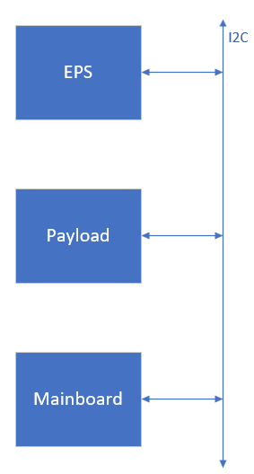
Power Distribution and Communication

Slide 3
Mainboard

Slide 4
Payload

Slide 5
Secondary MCUs

Slide 6
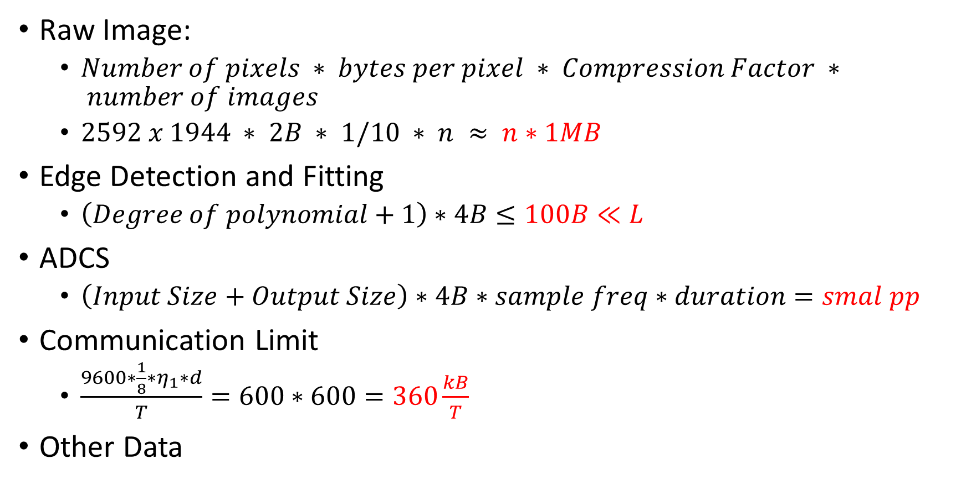
Memory
Raw Image:
$Number of pixels ∗ bytes per pixel ∗ Compression Factor ∗ number of images$
$2592 x 1944 ∗ 2B ∗ 1/10 ∗ n ≈ n∗1MB$
Edge Detection and Fitting
$\left(Degree of polynomial+1\right)∗4B≤100B≪L$
ADCS
$\left(Input Size+Output Size\right)∗4B∗sample freq∗duration=smal pp$
Communication Limit
$\frac{9600∗\frac{1}{8}∗η_{1}∗d}{T}=600∗600=360\frac{kB}{T}$
Other Data

Slide 7
Memory
We suggest a rad-hard program memory and at least tens of megabytes of bulk memory

Slide 8
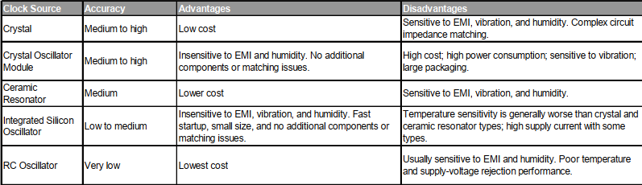
Clock

Slide 9
Clock

Slide 10
FPGA

